Slide 1
Previous Cycle, Star-Dist Autofocus

Slide 2
Idea and Assumptions
To acquire data, we currently acquire zstacks about the approx. focus plane in order to make certain that the in focus image is captured.
An issue with this method is the focal plane shifts slowly over time leading to needing larger stacks or to adjust the center position of the z stack to be closer to the focal plane.
In the past strategies like triple image brenner score work well, but fail too often to be relied upon. A much larger scanning stack can be used, but it is very time consuming.
The presented method is based up using the prior cycle’s dapi images and recentering the stack on the most in focus image.
To find the true nuclei and not just junk plus nuc plus other stuff like autofluorescence, we employ the pretrained stardist network to identify nuclei.
Bonus info may be to use segmented binary version of stardist output to identify where tissue is and indicated those so only those area need to be acquired.
Assumptions
Crux of this method working is that I have drift of < 2-4um in a single cycle.
Cycle 0 in focus images are in initial stack. Aka, micromagellan surface is set in focus from the start.

Slide 3
Workflow
Cycle 0 image Acquire
Segment via StarDist to generate mask
Calculate brenner score on masked nuclei images from z-stack n and find highest value
Shift position in focus map to center the highest brenner score slice
Acquire cycle n z-stack (if n=0, use cycle 0 image stack instead)
Apply shifted focus map to acquire new z-stack for cycle n+1
Initial mask generation

Slide 4
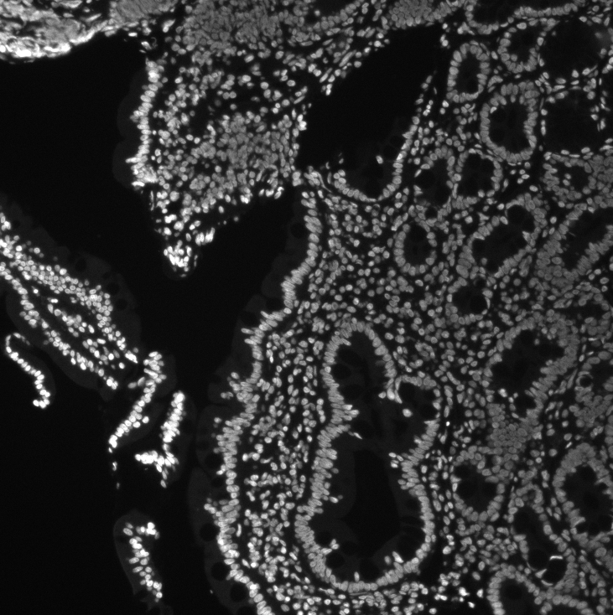
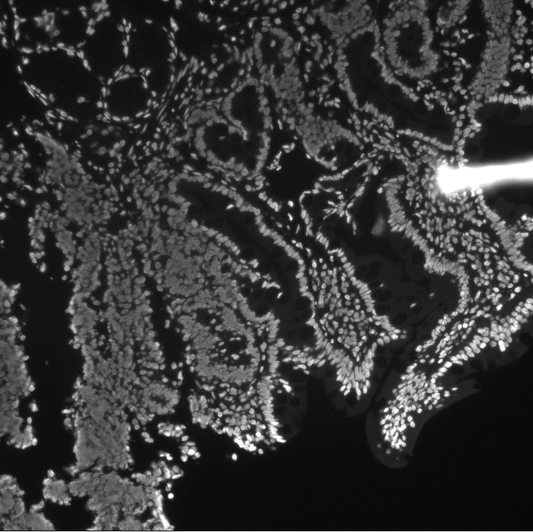
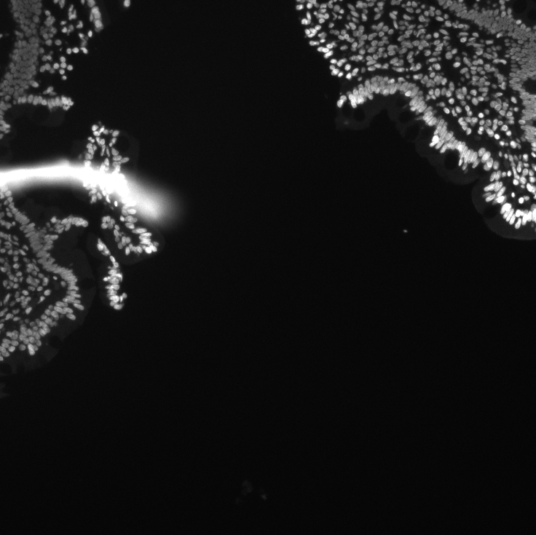
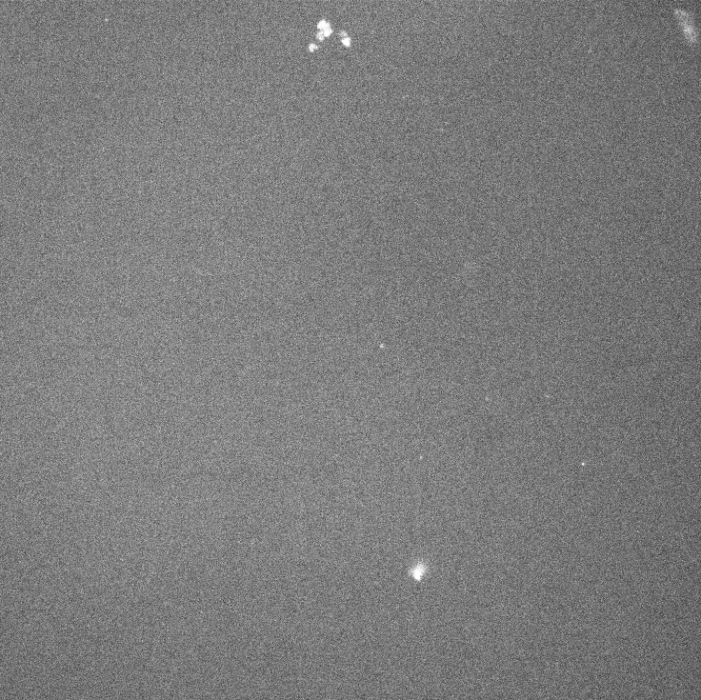
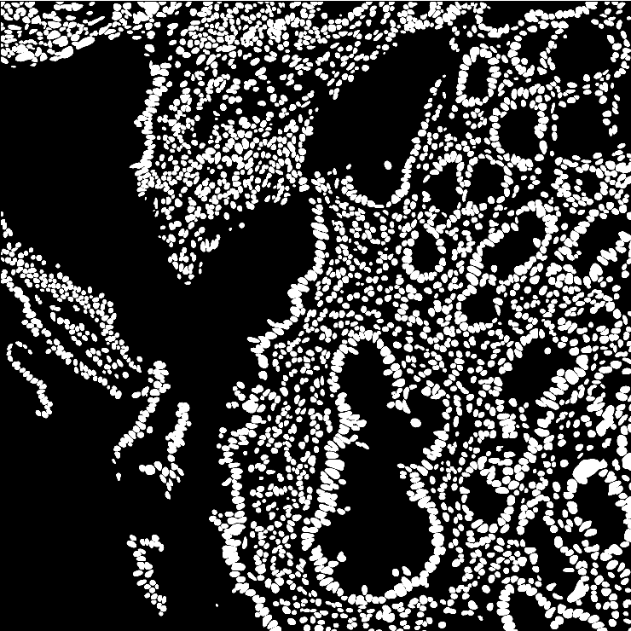
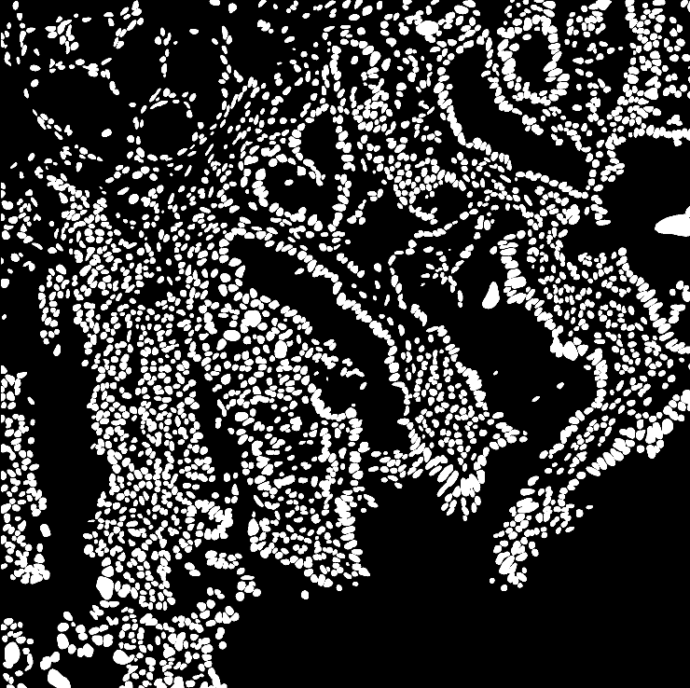
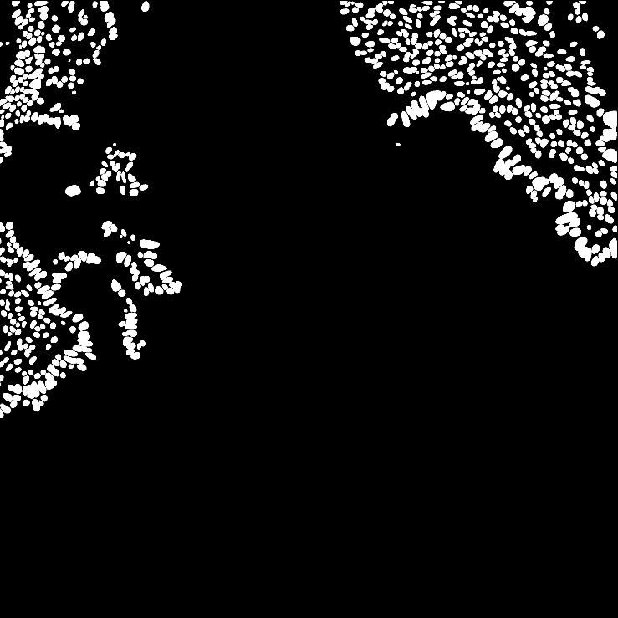

Images to Mask
Images
Masks

Slide 5
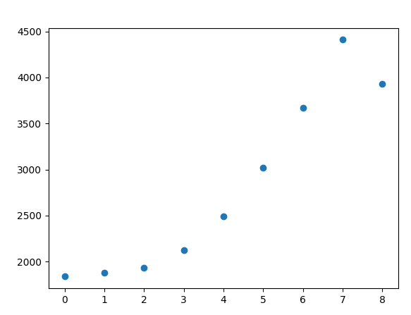
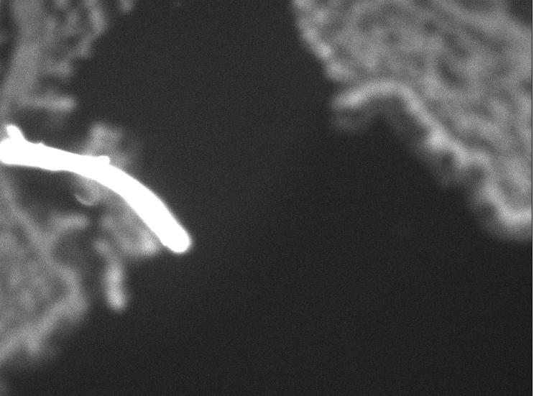
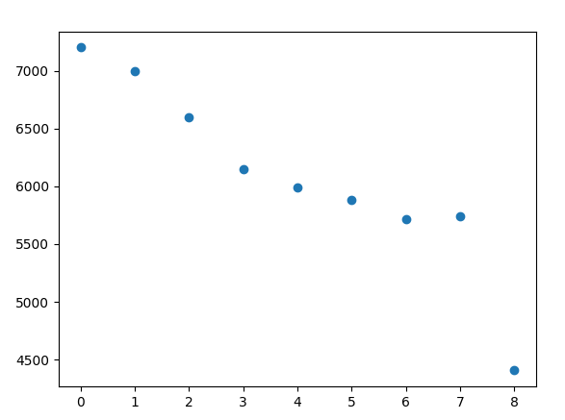
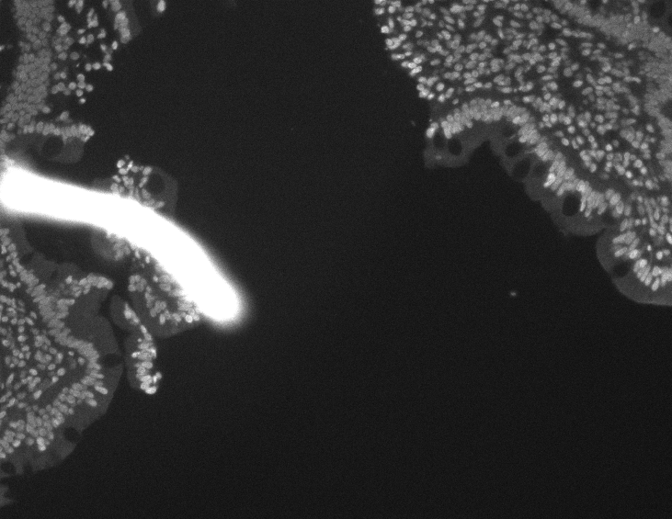
With/Without Stardist
Without Star dist
Slice 7
With Star dist
Slice 0

Slide 6
